Slide 1
How Heterogeneity Impacts Learning

Slide 2
Motivation

Slide 3
Social Learning Is Oddly Influential
Peers have limited experience
Authorities test recommendations extensively
Yet, both induce adoption at equal rates
Krishnan and Patnam (2013)
Takahashi, Mano, and Otsuka (2019)
Implies social learning is more influential per data point

Slide 4
What’s the mechanism?
Natural questions:
Why?
Is social learning special?
How can authorities improve?

Slide 5
My Proposal: Context Uncertainty
Peer information comes with rich context
Information from authorities comes with little context
When weighing signals, we place weight on total uncertainty
Total Uncertainty = Context Uncertainty + Sampling Error

Slide 6
Related Literature
Decision makers as statisticians
Steiner and Stewart (2008), Olea et al. (2021), Salant and Cherry (2020), etc..
Social learning theory
Sethi and Yildiz (2016), Dasaratha et al (2022), Bala and Goyal (1998), etc…
Information provision experiments
Jensen (2010), Chetty and Saez (2013), Binder (2020), etc…
Role of heterogeneity in agents’ responses to information
Armour (2018),
Role of trust in agents’ responses to information
asdf
Agricultural technology adoption
asdf
Agricultural extension design
asdf

Slide 7
Roadmap
Today:
Relate question to agricultural technology adoption
Propose a foundation for mechanism
Provide experimental design
Present results
Discuss external validity
Implications for farmers and policymakers
Upcoming extensions

Slide 8
Setting

Slide 9
Low AgTech Adoption Is A Major Issue
$2^{\text{nd}}$ divergence via Green Revolution (Huang, 2020)
Key friction for AgTech (Magruder, 2018)
Governments spend huge sums on extension (Akroyd and Smith, 2007)

Slide 10
Traditional Extension Design
R&D at university or national research institute
Pick a winning technology
Agricultural ministry teaches extension staff
Extension staff advocate in villages
Villagers have no clue about test conditions

Slide 11
Microfoundation

Slide 12
The Farmer’s Problem
Problem:
$$\underset{α}{argmax}E\left[U\left(α⋅θ_{i}\right)|s_{1},…s_{n},s_{E}\right]$$
Decision: Fraction of investment $α∈\left[0,1\right]$
Heterogeneity:
$$ \ \ \ \ \ \ \ \ \ \ \ \ \theta_i = \underbrace{\theta \vphantom{\gamma_i} }_{\text{average return}} + \underbrace{\gamma_i}_{\text{context adjustment}} $$
Belief: Posterior ${\tilde{θ}}_{i}$
Preferences: Risk averse so
$$E\left[U\left(αθ_{i}\right)\right]≤U\left(αE\left[θ_{i}\right]\right).$$

Slide 13
Interpreting Signals from peers
Friend $j$ shares signal
$$ s_j = \underbrace{\theta\vphantom{\gamma_j}}_{\text{Average Return}} + \underbrace{\gamma_j}_{\text{Agent $j$'s Context}} + \underbrace{\epsilon_j}_{\text{Agent $j$'s Sampling Error}}. $$
Farmer’s belief about $γ_{j}$ is
$$γ_{j}∼N\left(0,{\left(σ_{j}^{γ}\right)}^{2}\right).$$
Farmer knows friend $j$ well, so context uncertainty $σ_{j}^{γ}$ is low.

Slide 14
Interpreting Signals from Authorities
Extension agent $E$ shares signal
$$ s_E = \underbrace{\theta\vphantom{\gamma_E}}_{\text{Average Return}} + \underbrace{\gamma_E}_{\text{Agent's Context}} + \underbrace{\epsilon_E}_{\text{Agent's Sampling Error}}. $$
Farmer’s belief about $γ_{E}$ is
$$γ_{E}∼N\left(0,{\left(σ_{E}^{γ}\right)}^{2}\right).$$
Farmer doesn’t know any context, so $σ_{E}^{γ}$ is high.

Slide 15
Adjusting Signals for Context
How does the farmer adapt the signal to his own context?
$$\begin{matrix}\text{Adjusted Signal} & =\text{Original Signal} \\ & +\text{Own Context Adjustment} \\ & −\text{Friend’s Context Adjustment}\end{matrix}$$
Implication:
↑ context uncertainty ⇒ ↑ variance in adjusted signal

Slide 16
Our Farmer’s Posterior
Using information from all sources, farmer updates his belief.
$$\begin{matrix}\text{Mean} & ∝\frac{0}{\text{Prior Var}}+\frac{\text{Ext Adj Signal}}{\text{Ext Sample Var}+\text{Ext Context Var}} \\ & +∑\frac{\text{Peer Adj Signal}}{\text{Peer Sample Var}+\text{Peer Context Var}}\end{matrix}$$

Slide 17
Less Context → Less Investment
Consider a strictly risk averse agent with utility $U$ solving
$$\underset{α}{argmax}E\left[U\left(α⋅θ_{i}\right)|s_{1},…s_{n},s_{E}\right].$$
The agent’s optimal level of adoption $α^{*}$ is decreasing in context uncertainty from any signal.

Slide 18
Sampling and Context Precision Are Complements
Consider a strictly risk averse agent with DARA utility $U$ solving
$$\underset{α}{argmax}E\left[U\left(α⋅θ_{i}\right)|s_{1},…s_{n},s_{E}\right].$$
For any signal $s_{j}$, the amount that the agent’s optimal level of adoption $α^{*}$ increases from a unit increase in sampling precision $1/σ_{j}^{2}$, is increasing in context precision ${\left(1/σ_{j}^{γ}\right)}^{2}$ from that signal.

Slide 19
Model Recap
Heterogeneity can cause uncertainty about context
Context uncertainty adds to signal noise
Context can be adjusted for when certain
Hypothesis 1: Higher context uncertainty reduces adoption if risk averse
Hypothesis 2: Sampling and context precision are complements under DARA

Slide 20
Lab Experiment Design

Slide 21
Overview
Lab-in-the-field experiment in rural Odissa
1,600 small and marginal farmers
Decide whether to adopt a hypothetical technology
Receive noisy signals from fictional characters
Vary only context uncertainty
Choose adoption level

Slide 22
Signals As Likert Scales
Everyone is learning about their $θ_{j}$
Report experience using an emoji Likert scale
Each signal $s_{j}$ is shared only with the participant

Slide 23
Contexts As Types
Characters are one of two types: orange or blue
The participant is the orange type
Type is a summary of all dimensions of context
$θ_{O}$ and $θ_{B}$ are homogenous

Slide 24
Introducing Sampling Error
Even within type, $s_{j}$ are not identical
Reflects idiosyncratic risk
Drawn from $θ_{O}+ϵ$ or $θ_{B}+ϵ$
Error $ϵ$ is identical and independent

Slide 25
Learning From Blue Types
Blue type always does worse
Provide story about rainwater catchment
Difference of two Emoji

Slide 26
What We Have So Far
So far, our game looks like this:
Where’s the context uncertainty?
Where’s the decision making?

Slide 27
Adding Context Uncertainty
Some characters have unknown type
They appear as gray
Could be either type

Slide 28
Deciding Adoption Intensity
Land divided into 10 rows
Must decide adoption maximizing yield
Mapped to Likert Scale

Slide 29
Bringing it all together
Player sees information and decides adoption level

Slide 30
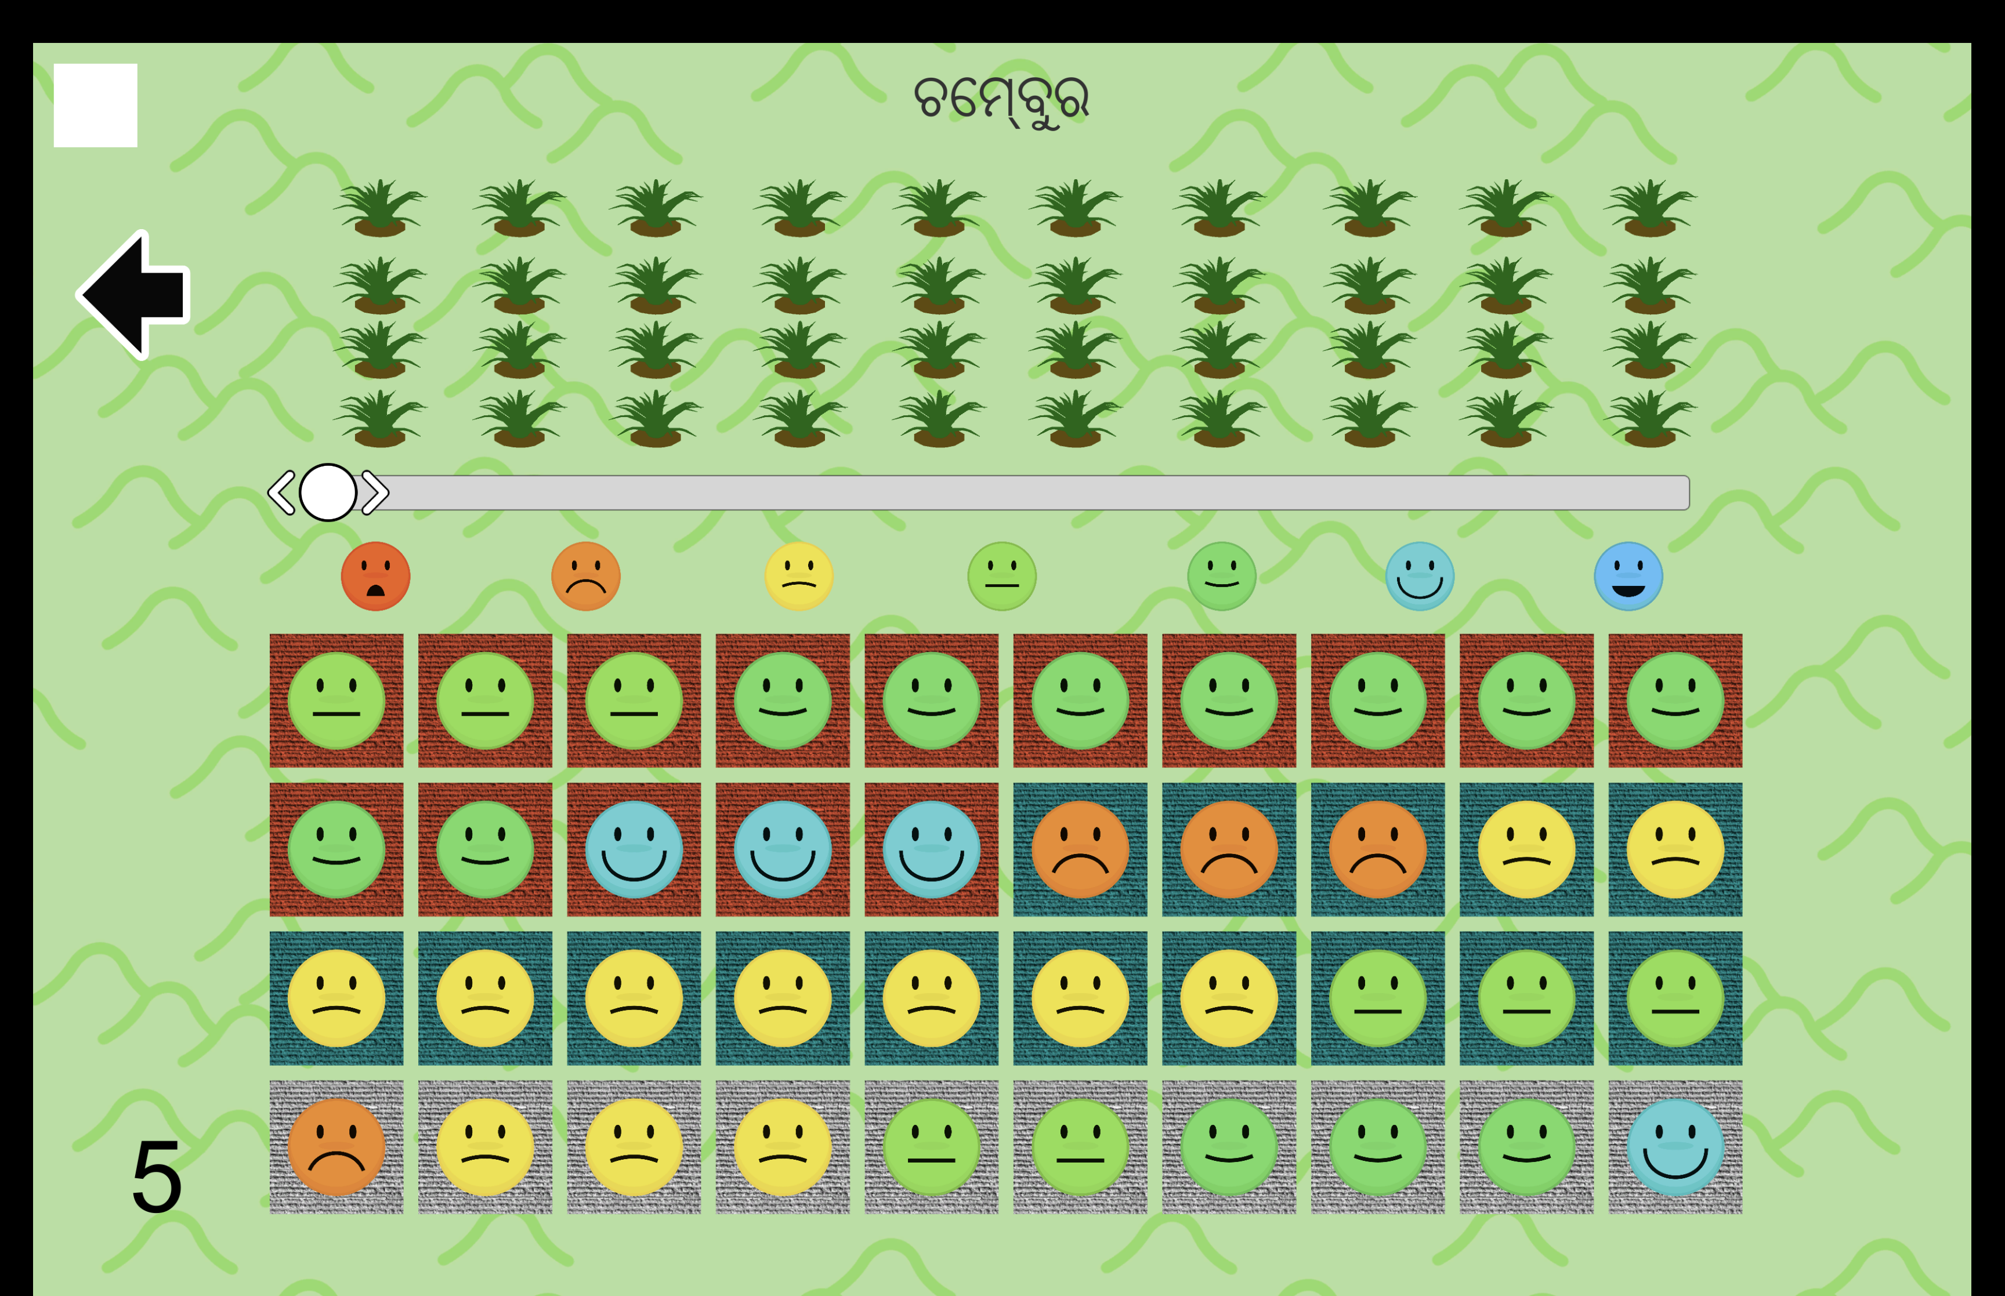
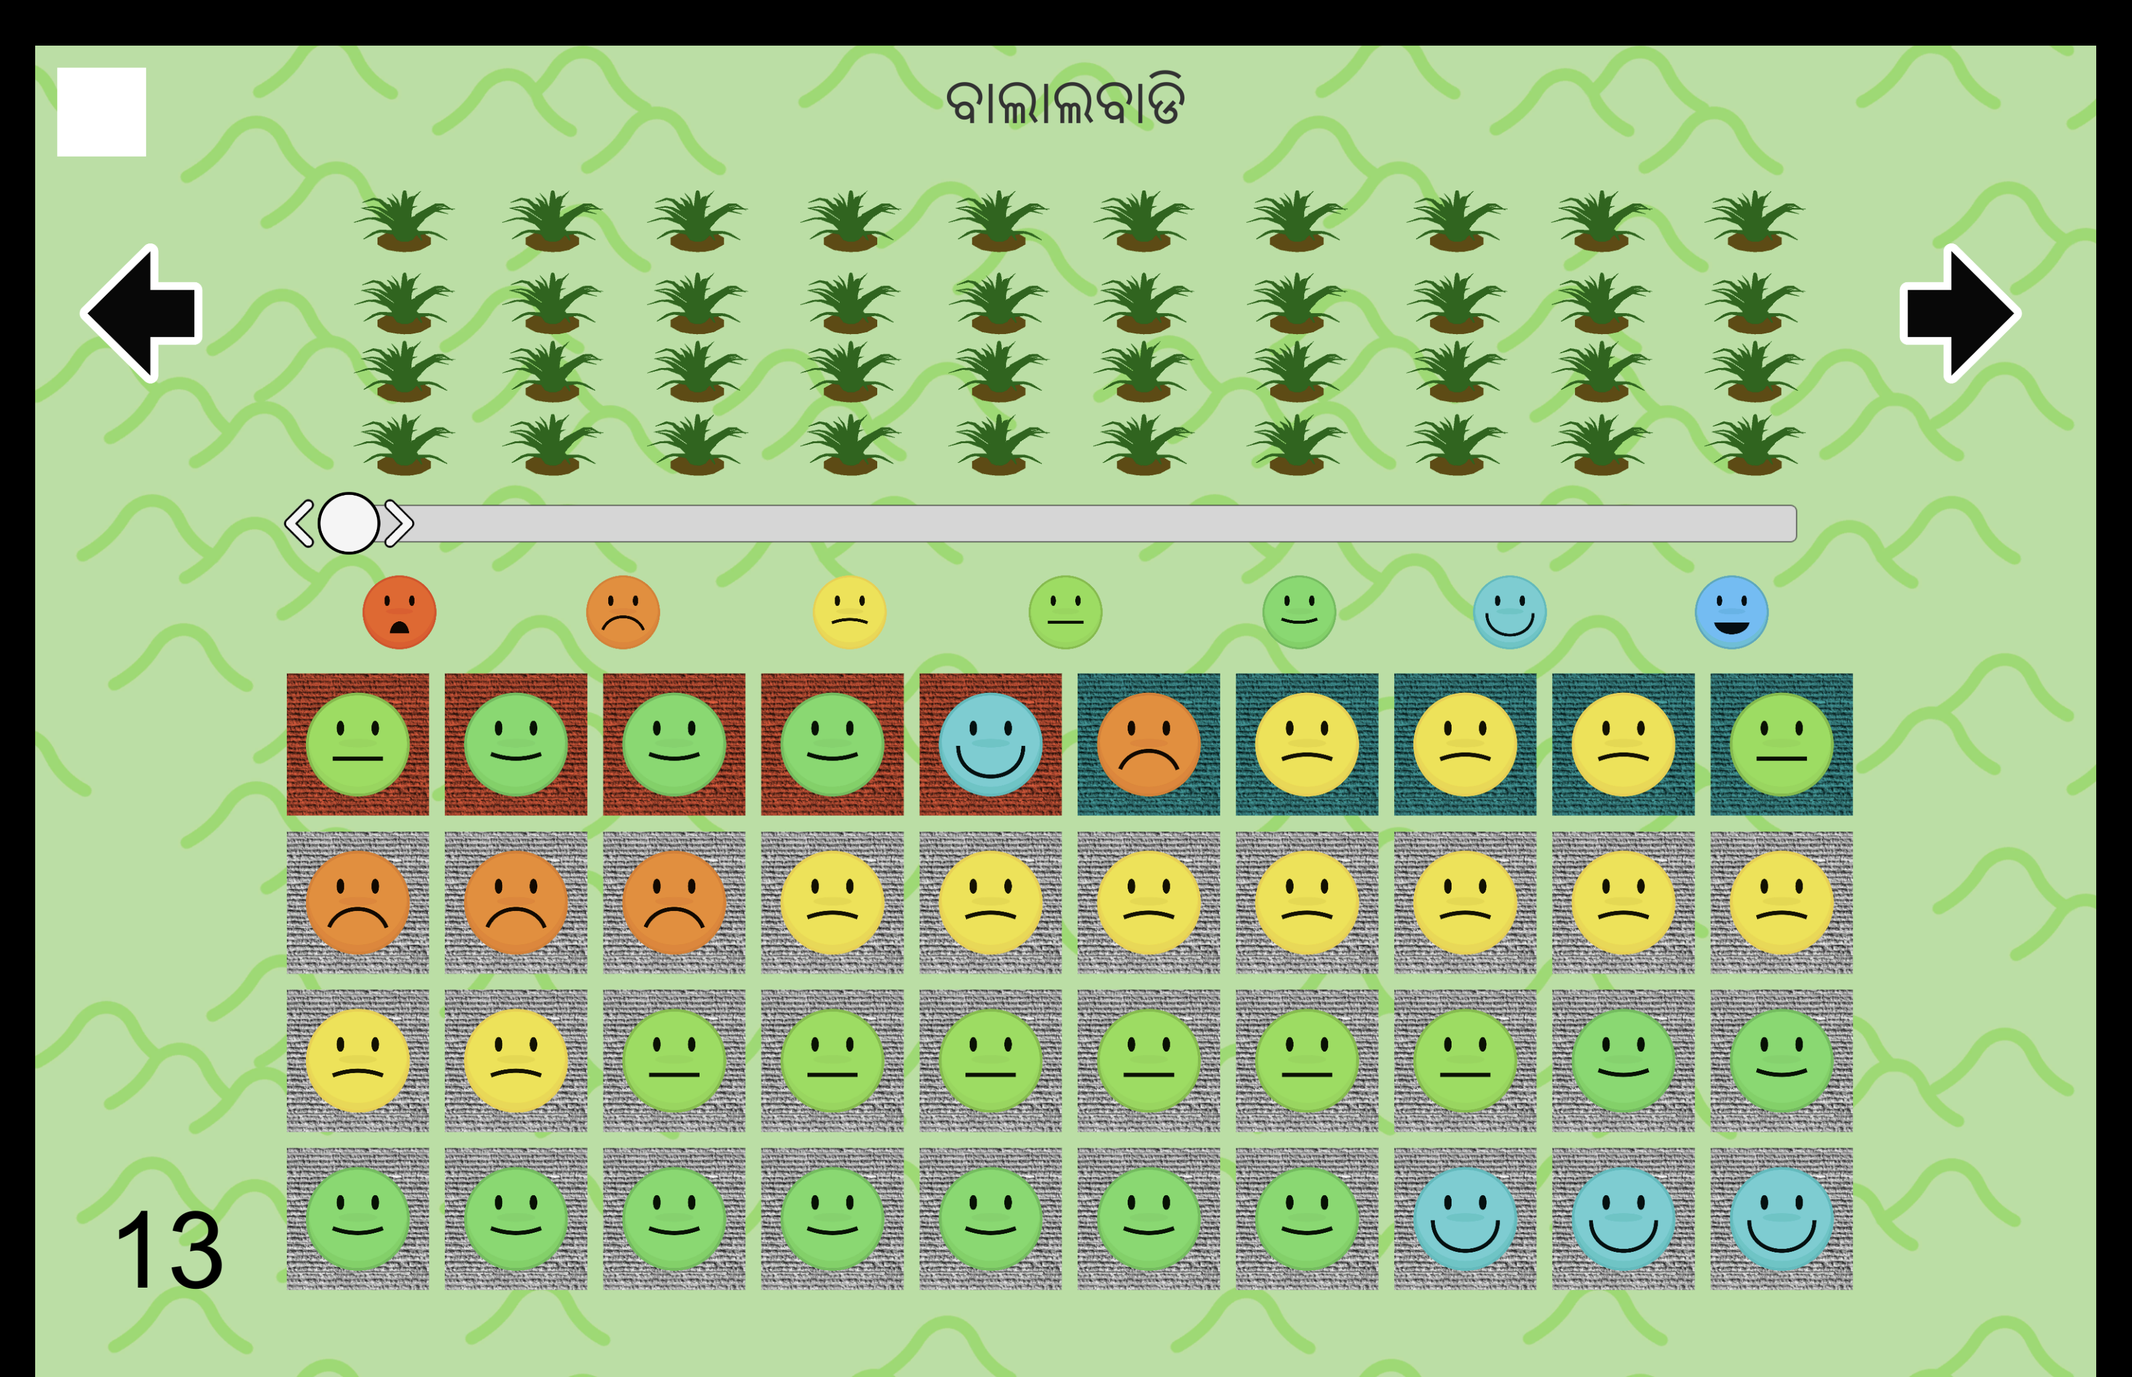

Slide 31
Process and Randomization
Survey participant
Read game script
Practice module
Game modules
Randomize round order via matched quartets
Randomize technology order
Randomize village name order
Payout

Slide 32
Results

Slide 33
How Context Uncertainty Aversion Is Tested
Identification: Two game rounds. Only change % gray
Specification:
$$AdoptionLevel_{it}=β_{1}⋅1_{t=\text{High }\%\text{ Gray}}+η_{i}+ϵ_{it}$$

Slide 34
Farmers Prefer More Context

Slide 35
Shifts in Adoption

Slide 36
How Complementarity Is Tested
Identification: Two modules. Low vs high sampling error.
Change % gray within each.

Slide 37
How Complementarity Is Tested
Specification: Use diff-in-diff (i.e. Athey and Stern, 1998)
$$ AdoptionLevel_{it} = \\ \beta_1 \cdot \left[ \left( \mathbb{1}_{t = \text{High } \% \text{ Gray}}\cdot \mathbb{1}_{t = \text{Wide} \text{ Emoji}} - \mathbb{1}_{t = \text{High } \% \text{ Gray}}\cdot \mathbb{1}_{t \neq \text{Wide} \text{ Emoji}} \right) \\ - \left( \mathbb{1}_{t \neq \text{High } \% \text{ Gray}}\cdot \mathbb{1}_{t = \text{Wide} \text{ Emoji}} - \mathbb{1}_{t \neq \text{High } \% \text{ Gray}}\cdot \mathbb{1}_{t \neq \text{Wide} \text{ Emoji}} \right) \right] \\ + \eta_i + \epsilon_{it} $$

Slide 38
Uncertainties May Be Complementary

Slide 39
Dropped Enumerators Improve Significance

Slide 40
External Validity: Survey Evidence

Slide 41
Farmers Consider Extension Agents Less Than Peers
59% of farmers consider a peer more useful.
Why?
$97\%$ cite less experience
$>40\%$ cite more heterogeneity (budget, land, resources)
Only $5\%$ suspect ulterior motives (i.e. corruption)
Farmers Strongly Prefer Similar Test Plots

Slide 42
External Validity: Existing Field Experiments

Slide 43
Other Potential Mechanisms
Some potential mechanisms:
Sample size
Centrality
Social influence
Homophily
None are broadly consistent with the literature
Program design more effective when mechanism is known
RCTs have difficulty isolating mechanisms

Slide 44
What works and why?
 | Sample Size | Centrality | Social Power | Homophily | Context
Decentralized Learning
Field Days
Season-long Demonstration Plots
Seed Centrality
Opinion Leader Superiority
Demonstration Plot Centrality
Direct Contact Farmer Training
ICT to Reduce Temporal Lag

Slide 45
What works and why?
 | Sample Size | Centrality | Social Power | Homophily | Context
Decentralized Learning | ✗
Field Days
Season-long Demonstration Plots
Seed Centrality
Opinion Leader Superiority
Demonstration Plot Centrality
Direct Contact Farmer Training
ICT to Reduce Temporal Lag

Slide 46
What works and why?
 | Sample Size | Centrality | Social Power | Homophily | Context
Decentralized Learning | ✗
Field Days
Season-long Demonstration Plots
Seed Centrality |  | ✓
Opinion Leader Superiority
Demonstration Plot Centrality |  | ✗
Direct Contact Farmer Training
ICT to Reduce Temporal Lag

Slide 47
What works and why?
 | Sample Size | Centrality | Social Power | Homophily | Context
Decentralized Learning | ✗
Field Days |  |  | ✗
Season-long Demonstration Plots
Seed Centrality |  | ✓ | ✓
Opinion Leader Superiority |  |  | ✗
Demonstration Plot Centrality |  | ✗ | ✗
Direct Contact Farmer Training
ICT to Reduce Temporal Lag

Slide 48
What works and why?
 | Sample Size | Centrality | Social Power | Homophily | Context
Decentralized Learning | ✗ |  |  | ✓
Field Days |  |  | ✗
Season-long Demonstration Plots
Seed Centrality |  | ✓ | ✓ | ✗
Opinion Leader Superiority |  |  | ✗ | ✓
Demonstration Plot Centrality |  | ✗ | ✗
Direct Contact Farmer Training
ICT to Reduce Temporal Lag

Slide 49
What works and why?
 | Sample Size | Centrality | Social Power | Homophily | Context
Decentralized Learning | ✗ |  |  | ✓ | ✓
Field Days |  |  | ✗ |  | ✓
Season-long Demonstration Plots |  |  |  |  | ✓
Seed Centrality |  | ✓ | ✓ | ✗ | ✓
Opinion Leader Superiority |  |  | ✗ | ✓ | ✓
Demonstration Plot Centrality |  | ✗ | ✗ |  | ✓
Direct Contact Farmer Training |  |  |  |  | ✓
ICT to Reduce Temporal Lag |  |  |  |  | ✓

Slide 50
Possible Extensions

Slide 51
Conclusion

Slide 52
Potential Implications
Potential lessons:
Info campaigns should provide specific returns
Information campaigns should disaggregate returns
Distributed, local experimentation could increase trust
Insurance with low basis-risk, when tied to experimentation, can have high positive externalities
Reinforces Oates (1972, 1999) argument in favor of decentralization

Slide 53
Future area of study
Barriers to signal translation
Specific vs disaggregated signals

Slide 54
Thank You

